Slide 1
Peripheral Thinking – The Valve Steam Controller
Jonah Venglarcik

Slide 2
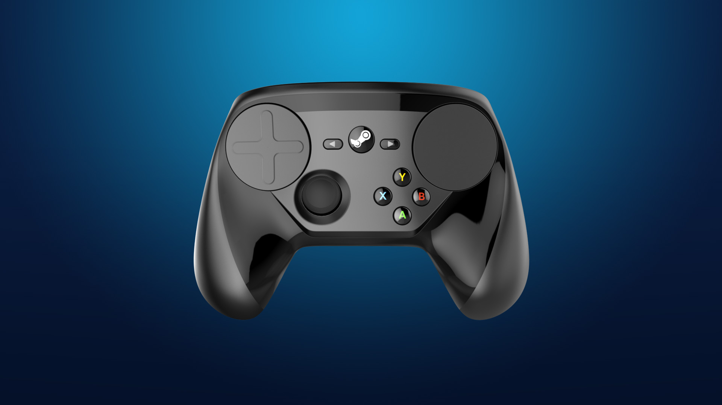
The Steam Controller
Created by Valve Corporation
Released on November 10th, 2015
A compromise between two control methods
The accuracy & customizability of keyboard and mouse
Form factor of a gamepad
Notes:
The Steam Controller is a PC game controller that was created by Valve Corporation – a developer best known for the PC gaming platform Steam, and game series such as Portal, Half-Life, and Counter-Strike.
Before the release of the Steam Controller, Valve was primarily a software company, with extremely minimal pipelines for hardware design and manufacturing. The Steam Controller initially began as a small internal project – a controller with inputs of various kinds mashed together; some prototypes included touchpads, trackballs, touch screens, and of course the standard joysticks and face buttons, among other features. The project gained traction within Valve, and more serious efforts were put forth to develop this device into a fully featured controller. Eventually, after several extreme (and public) redesigns, Valve finally released the Steam Controller in November of 2015.
Valve’s ultimate intention with the controller was to create an input device for their PC gaming platform that could act as a cross between the accuracy and customizability of the traditional PC keyboard & mouse, but with the comfortability and familiarity of a classic gamepad controller. It was designed such that any game on PC (particularly on Steam) could be played with it – even games that didn’t have native support for controllers. Although the controller was extremely innovative in terms of both the design of its hardware, and the incredible capabilities of its software, it was ultimately seen as a failure by the general PC games community.

Slide 3
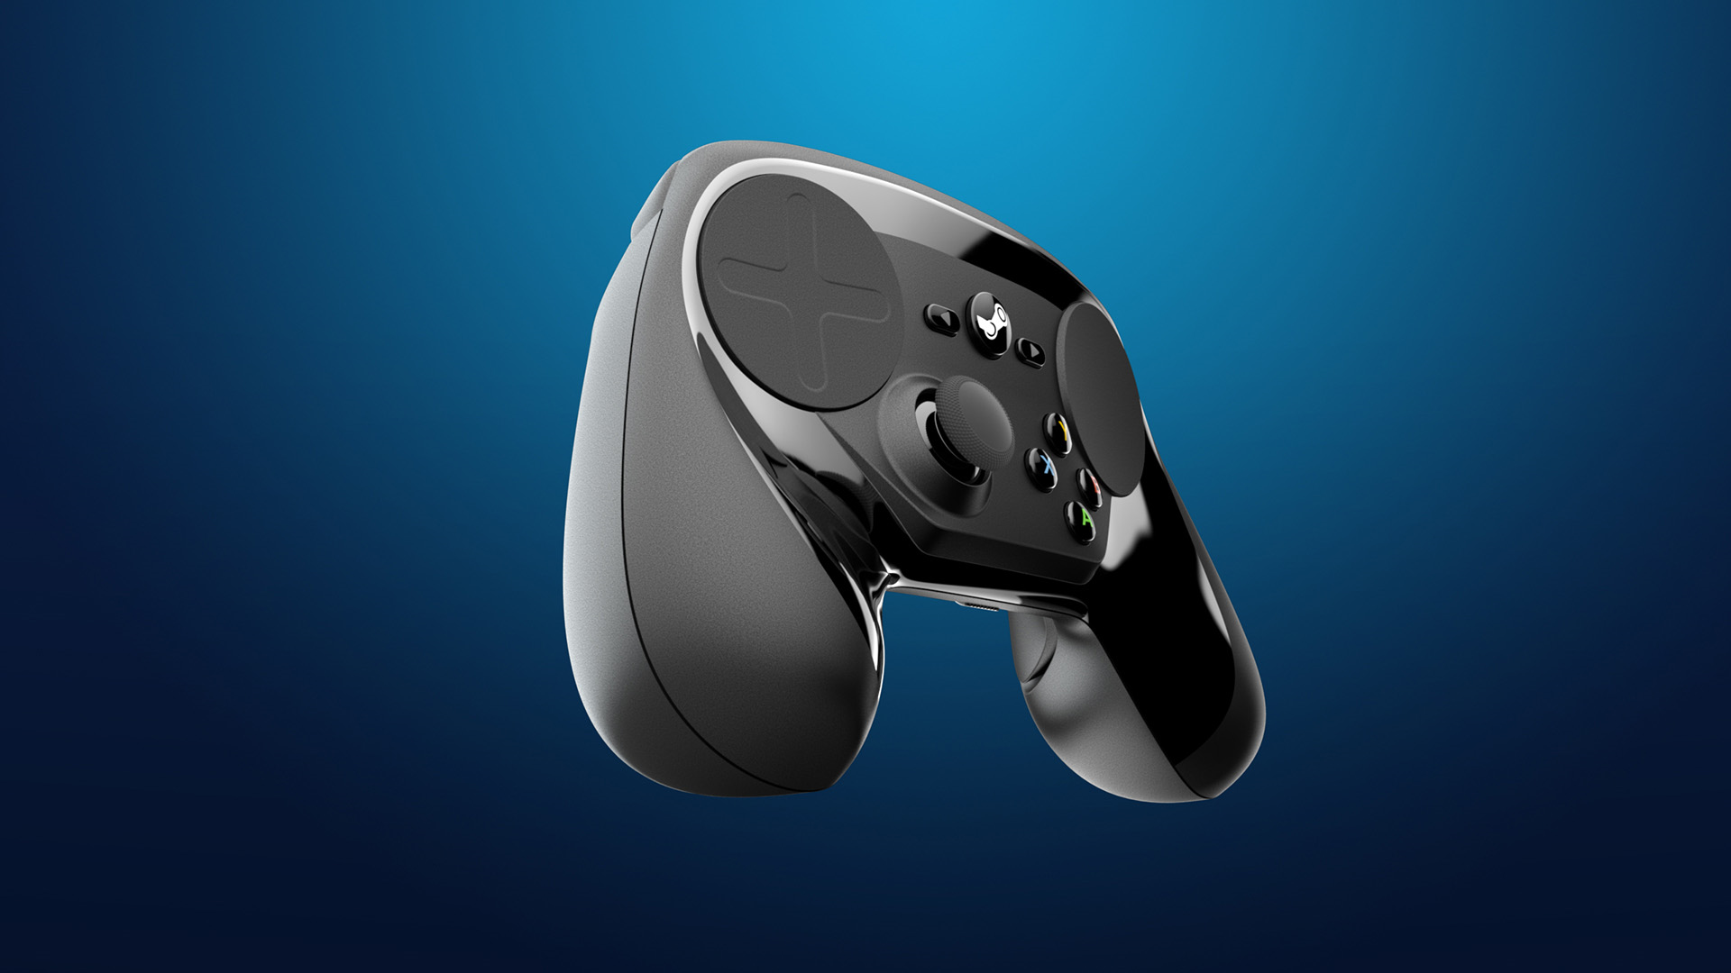
Hardware
What’s familiar?
What’s new?
ABXY Face buttons
Abnormally small
Uncomfortable location
Joystick
Only one!
Start, Select, Home
Trackpads
More accurate than a joystick, less accurate than a mouse
Rear paddles
Dual-stage triggers
Gyroscope
Enables another layer of accuracy
Starting to gain more appeal
Notes:
The Steam Controller’s perceived failure may first come from an assessment of the controller’s physical design. As a controller meant for gaming, it looks quite strange when compared to the other input devices it was meant to replace (seen on the next few slides).
Starting with what the Steam Controller did carry over from its cohorts, it of course includes the iconic four “face buttons”. Though the order and glyphs of these face buttons differ between the controllers of the major gaming brands, Valve adopted the Microsoft Xbox’s ABXY format here. This is because most PC games that do include controller support tend to only support the Xbox 360 and Xbox One gamepads, seeing as Microsoft’s Windows platform is the most popular for PC gaming. But despite the presence of this nearly universal game controller paradigm, the Steam Controller fumbles in the inclusion of these buttons. First, the buttons themselves are noticeably smaller than those on the Xbox controllers. Additionally, due to the unusual relative positioning of these buttons on the controller, it’s very easy for new users to mistake one button for another – a confusing problem further exacerbated by the fact that these ABXY buttons may be referenced under new names when the Steam Controller is configured for games that don’t support the Xbox button layout.
Another familiar inclusion to the Steam Controller is the joystick. Wait – joystick, singular? Yes indeed, the Steam Controller provides only one joystick, in stark contrast with the dual joystick setup on most modern game controllers, as popularized by the Sony PlayStation’s DualShock controller. In many games, the left joystick is used for movement, and the right joystick is used for camera control—the Steam Controller demands the user to ignore this in favor of its trackpads. Although these trackpads are far more accurate for camera movement than a controller’s joystick (not to mention the incredible level of customization that comes with them), this was enough to convince some gamers that it’s just not worth trading away such an accepted medium of game control.
Not all the Steam Controller’s features are bad. The controller featured two paddles on the back side, which could be reprogrammed like the rest of the controller; Microsoft even included a similar design for rear paddles on the premium Xbox One Elite Controller. Additionally, the dual stage triggers present on the controller allow for an additional level of customization for how inputs are received when pressing down the triggers.
The Steam Controller also includes a gyroscope, which can be used in several ways – most popularly, a more accurate method of aiming. Users discovered that while touching the trackpad or holding down a trigger, they could activate the gyroscope, using it as a camera to tune fine movements by simply moving the controller itself. This method of control is gaining popularity over 4 years later, with titles such as Warframe leveraging the Nintendo Switch’s powerful gyroscope for its third person aiming system—a much more accurate way to aim compared to the tiny and error-prone joysticks of the Nintendo Switch’s Joy Con controllers.
There is a strange mixture of old and new control methods present in the Steam Controller. It’s clear that in a physical regard, the controller was ahead of its time, yet also misguided in its approach to fostering familiarity from previous game controllers.

Slide 4
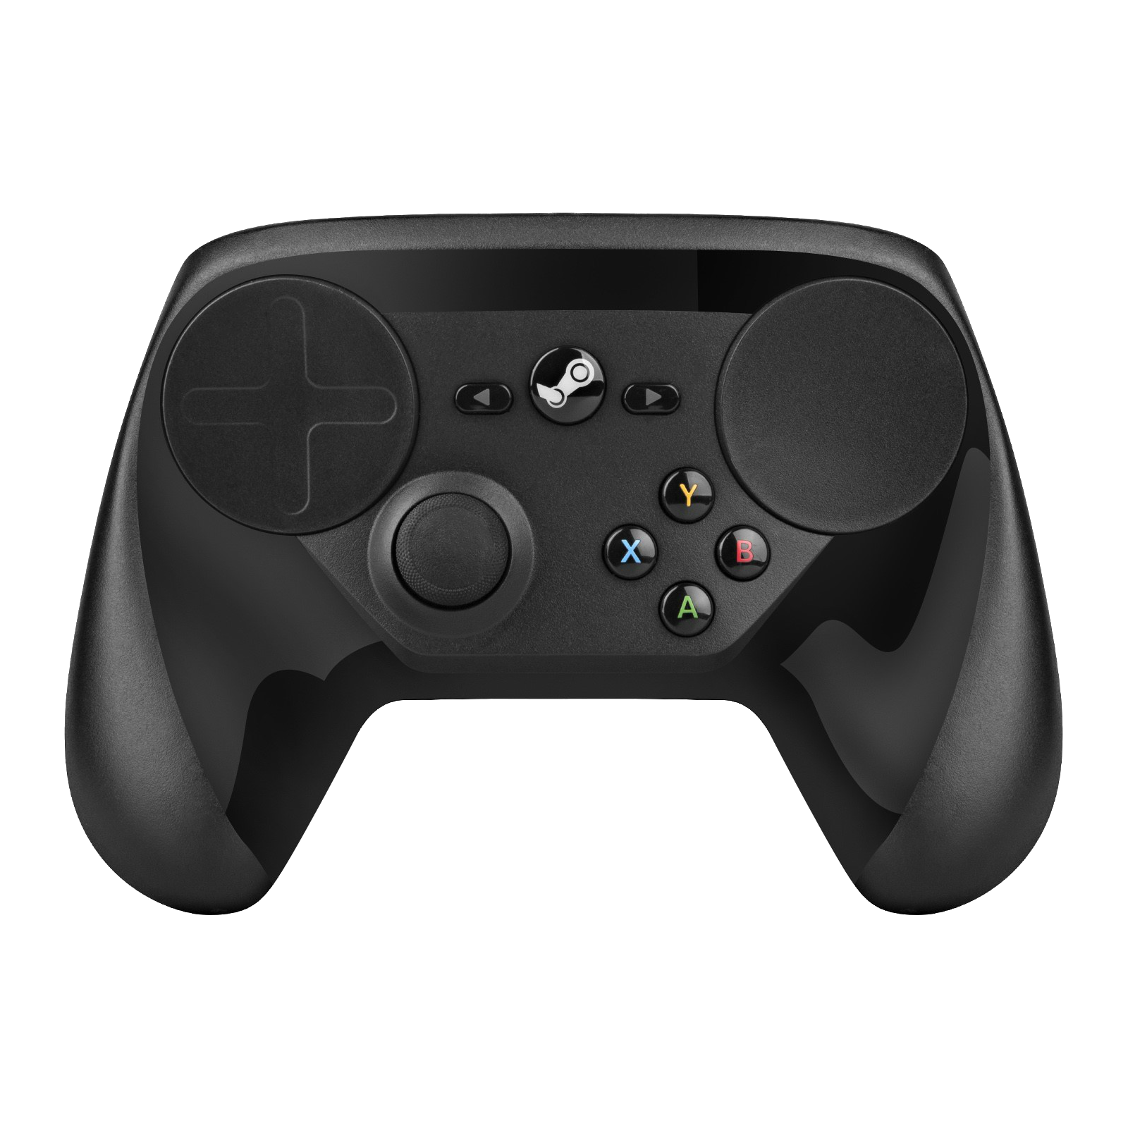
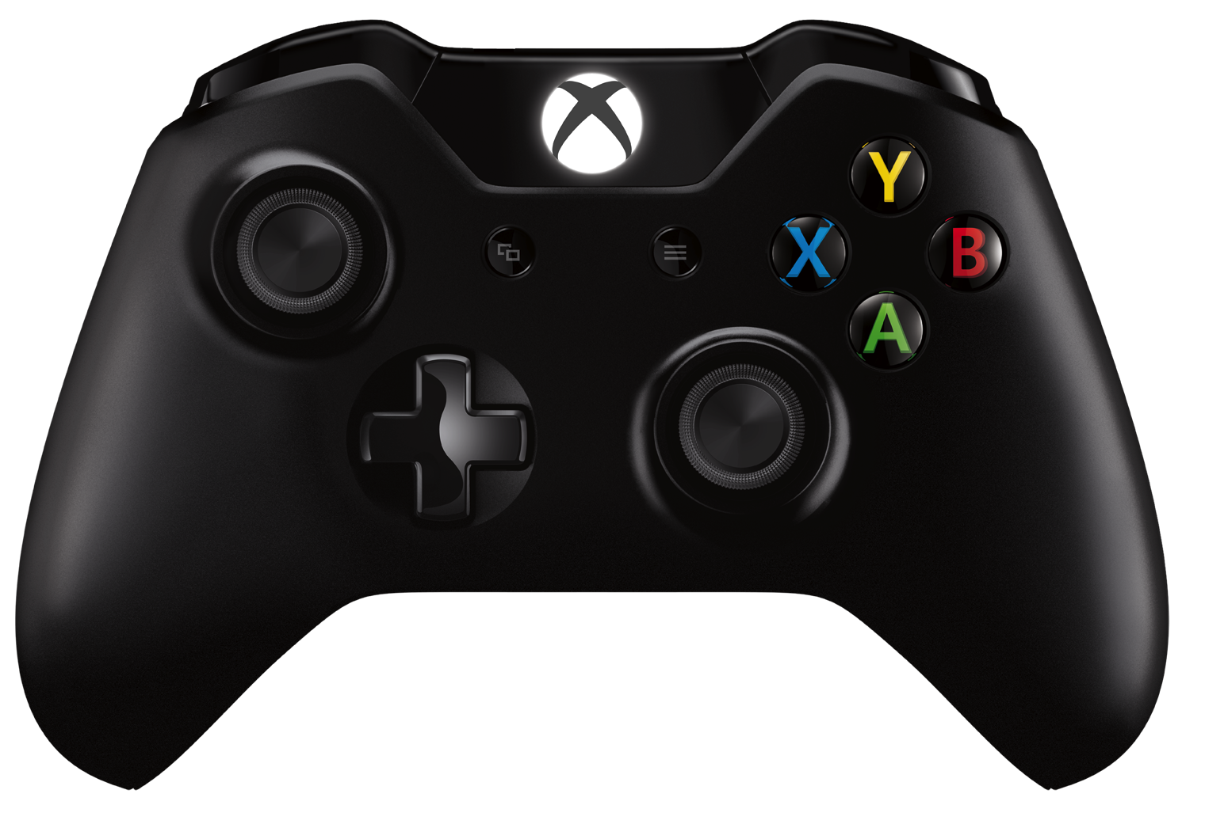
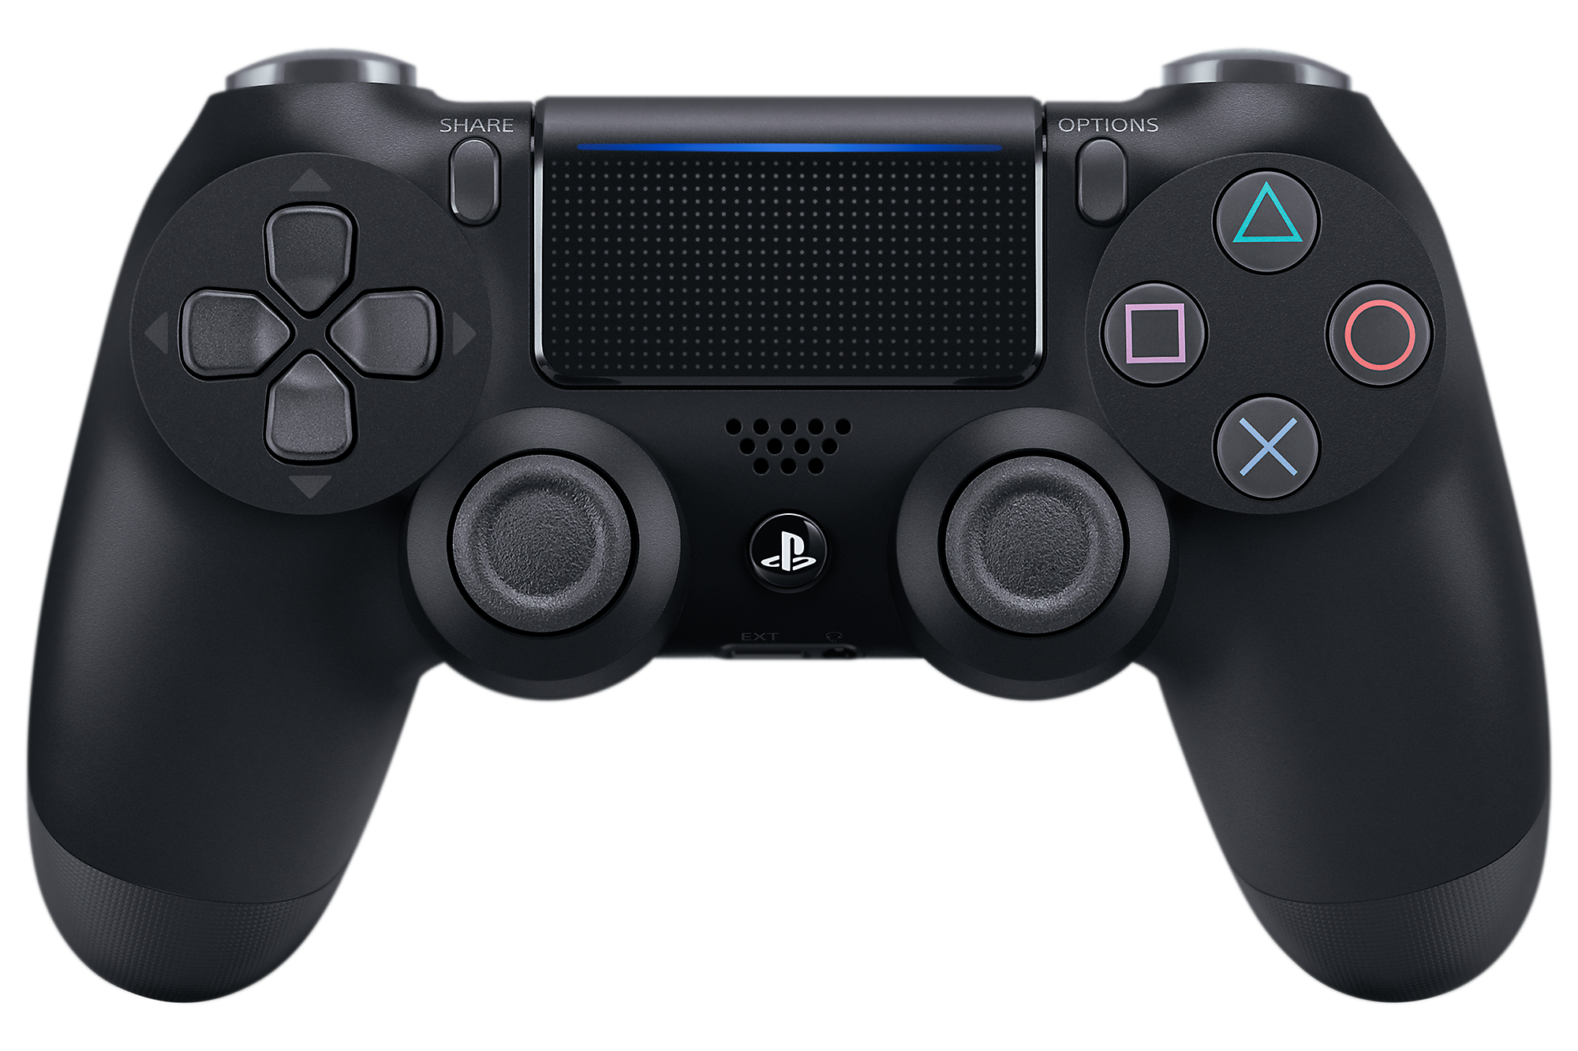
Steam Controller
Xbox One Controller
DualShock 4
Notes:
Notice how much space the trackpads take on the Steam Controller. It’s apparent that some compromises had to be made, like the lack of that second joystick, or the small size of the face buttons in relation to these other modern game controllers.

Slide 5
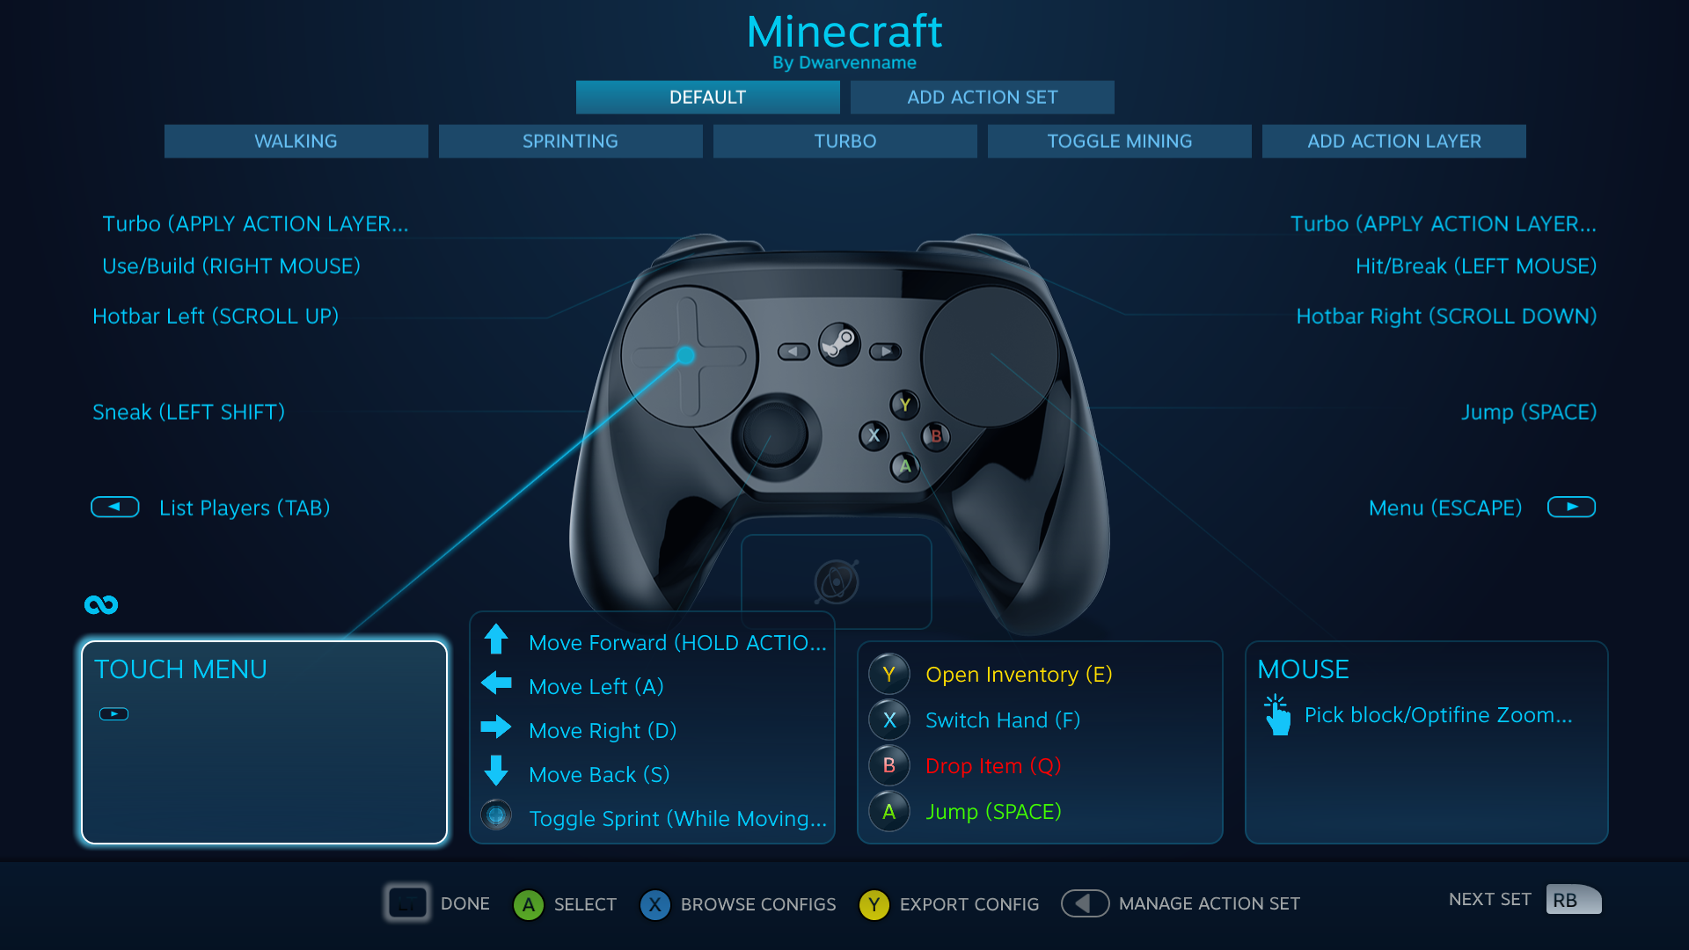
Software
SteamInput API
Supports more than just the Steam Controller
Easily integrated into PC Games
Extensive customization suite
Required to get an ideal experience
Confusing interface
Notes:
Although this presentation is meant to speak on how the Steam Controller failed as a hardware peripheral, it’s unfair to discuss this product without mentioning the extensive software tools that are included with it.
The SteamInput API is an input system that translates any connected controller’s inputs into a unified language that can be recognized by any game that supports keyboard & mouse or controllers. Though this system is designed to support more than just the Steam Controller, it does enable extraordinarily deep customization of the Steam Controller specifically.
From action layers, to touchpad menus, to the multiple styles of activators, to the acceleration curves of gyroscope and joystick movement, there is no limit to the level of customization the user can achieve with the Steam Controller. Yet, the robustness of Steam’s controller configurator software is also its downfall. For starters, there are just so many options behind every button, and the explanations for each setting are sorely lacking in illustration. Attempting to alter a complicated configuration (especially one that you didn’t create) is a confusing hassle, even for experienced users of the configurator. It doesn’t help either that this interface can often be quite buggy and sluggish. I’ve even run into situations where it becomes impossible to change a button’s mapping unless I create an entirely new configuration.
This customization isn’t necessarily optional, either. Though community and developer-made configurations can be of assistance when figuring out how the Steam Controller fits into a particular game’s control scheme, they are by no means a replacement. A user will always have specific preferences for which buttons on the controller do what for a given type of game, so being able to easily customize these is paramount. As I’ve said before, doing so is not a simple task with the configurator, unless you’re willing to spend (sometimes hours) tweaking configurations. This is something that I enjoy working on with games, but I absolutely understand how much of a hassle using the Steam Controller is for gamers who just want to plug and play.
The Steam Controller’s negative reception has largely stemmed from this aspect. With its software, the Steam Controller is a device that is very much designed for people who enjoy tweaking their games to get a perfect experience unique to them. Because of this, I don’t think it could have ever found mainstream appeal, but I still love how much freedom this device grants me to modify and tinker with a game’s controls.

Slide 6
“…it looks similar and performs the same function, but remains an overhaul so jarringly different it requires weeks or months of training to fully master.”
A tech reviewer reflects on the process of “learning” the Steam Controller briefly after its release in 2015.
Such a process is simply too much to ask of the average consumer, but it enables the previously impossible – playing PC-exclusive games from the couch being the prime example.
Sean Buckley, Engadget
Notes:
This quote accurately reflects the mindset of those who did embrace the Steam Controller’s versatility. It’s a powerful tool, for sure, but it’s hard to encourage someone to actively work against years of muscle memory for a chance at improvement.
This shows once more that the Steam Controller was both ahead of its time, and a niche product that was never meant for mainstream success.

Slide 7
Reception
Most people expected a traditional gamepad
Doesn’t necessarily replace the old forms of input
People were mad when they realized how much effort it took to set up for each game
Purists argued against using anything but a mouse for games where accuracy is needed
Some embraced its versatility
It takes time to get used to
Notes:
When the Steam Controller released in 2015, it did a lot of new things that reviewers didn’t expect. Most treated the Steam Controller as a total replacement for keyboard & mouse in PC gaming, but this was the wrong way of looking at it. The Steam Controller, in my eyes, is meant to be a tool for PC gamers to increase their comfort with games that they are intimately familiar with. It’s no fun to spend hours getting a game to work just to play it, so it would be foolish to try to use the controller with every single game. But to make a game one already enjoys playing that much more enjoyable? The Steam Controller fills that niche perfectly.

Slide 8
Legacy
Decent sales over time
Owned by less than 3% of Steam users
27.2 million Xbox 360 controller owners
11.5 million Xbox One controller owners
19.7 million other controller owners (DualShock 4, DualShock 3, Switch Pro, DualShock 2, Flight sticks, Gamecube, etc.)
1.3 million Steam Controller owners
Loyal fanbase
Notes:
In an article released in September of 2018, Valve revealed some statistics about the usage of controllers for gaming on the Steam platform, including usage and sales information for the Steam Controller. Up to September 2018, Valve had sold approximately 1.3 million Steam Controller units. With an MSRP of $50, and this many units moved, the Steam Controller was not really a commercial failure. But when compared to the overwhelmingly higher usage of most other controllers, the Steam Controller absolutely lacks in mainstream appeal.
Valve also notes in their report that Steam Controller users play a more diverse selection of games than any other controller type – most notably for games with either partial or no controller support. This illustrates that although Valve’s controller was a failure in the larger gaming sphere, it was a success in its goal to enable gamers (those willing) to adapt any game to their preferred control scheme.

Slide 9
“The Steam Controller is an amazing evolution in game control, but far too many gamers will never know. And all because change is hard.”
This demonstrates the failure of the Steam Controller perfectly.
No gamer wants to adapt to such a radically new control scheme, but they’re really missing out.
Sean Buckley, Engadget
Notes:
I’ll leave this presentation off with another quote from the Engadget review of the Steam Controller. I think that the Steam Controller was still a failure as a hardware product marketing to mainstream PC gaming consumers, but to me, it was a success in what it’s enabled me to do in games.

Slide 10
Works Cited
Buckley, Sean. “We Hate Valve's Steam Controller Because It's Different.” Engadget, 10 Nov. 2015, http://engt.co/1Np1IAo.
“Controller Gaming on PC.” Steam Community, Valve Corporation, 26 Sept. 2018, steamcommunity.com/games/593110/announcements/detail/1712946892833213377.
Doucet, Lars. “The Steam Controller Configurator's Untapped Power.” Gamasutra, 25 Jan. 2017, www.gamasutra.com/blogs/LarsDoucet/20170125/289904/The_Steam_Controller_Configurators_Untapped_Power.php.
Minicki, James. “The Steam Controller An Analysis – COMPLETE EDITION”. YouTube, 28 Nov. 2017, https://youtu.be/jJlASBfy83M.
“Steam Controller.” Steam, Valve Corporation, 10 Nov. 2015, store.steampowered.com/app/353370/Steam_Controller/.

